Slide 1
Task 4.2: GCIMS Integration
Zarrar Khan
Notes:
Image: Abstract Data Visualization – Stock Photo

Slide 2
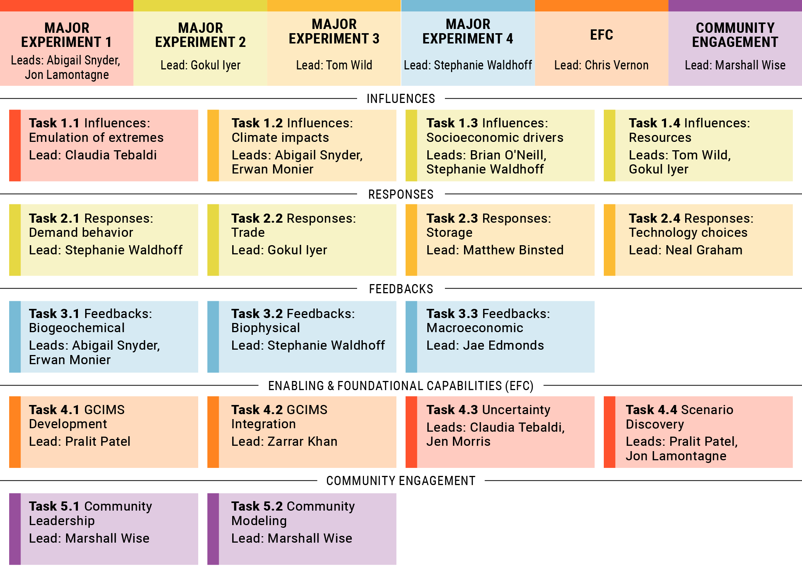
Task 4.2 GCIMS Integration in overall framework

Slide 3














Motivation – Robust, Resilient, Scalable Research
Data
Scripts
Scripts
Publications
1
Issue | Solution
5
Stranded Scripts
1
Packaged models
Outputs
Outputs
Stranded Knowledge
Software Map
Documentation
GCAM
v X.X
2
GCAM
v 5.4
4
Software Health
CI/CD
Stranded Model Versions
3
Analysis
Analysis
Reproducible
Workflows
6
Stranded Analysis
4
3
Data Management
Minting DOIs
Insights
Stranded Datasets
5
Models
Insights
Models
Dashboard
Persistent Insights
2
Stranded Insights
6
Teams
Teams

Slide 4






GCIMS Integration Roadmap
Software
Map
Reproducible
workflows
Persistent
Insights
2. What can we do?
4. Can we do it again?
6. How to share what we did?
1. Any stranded scripts?
3. Does it work?
5. How to re-use what we did?
Packaged
Models
Software Health
Data Management
https://jgcri.github.io/gcims_integration/index.html

Slide 5
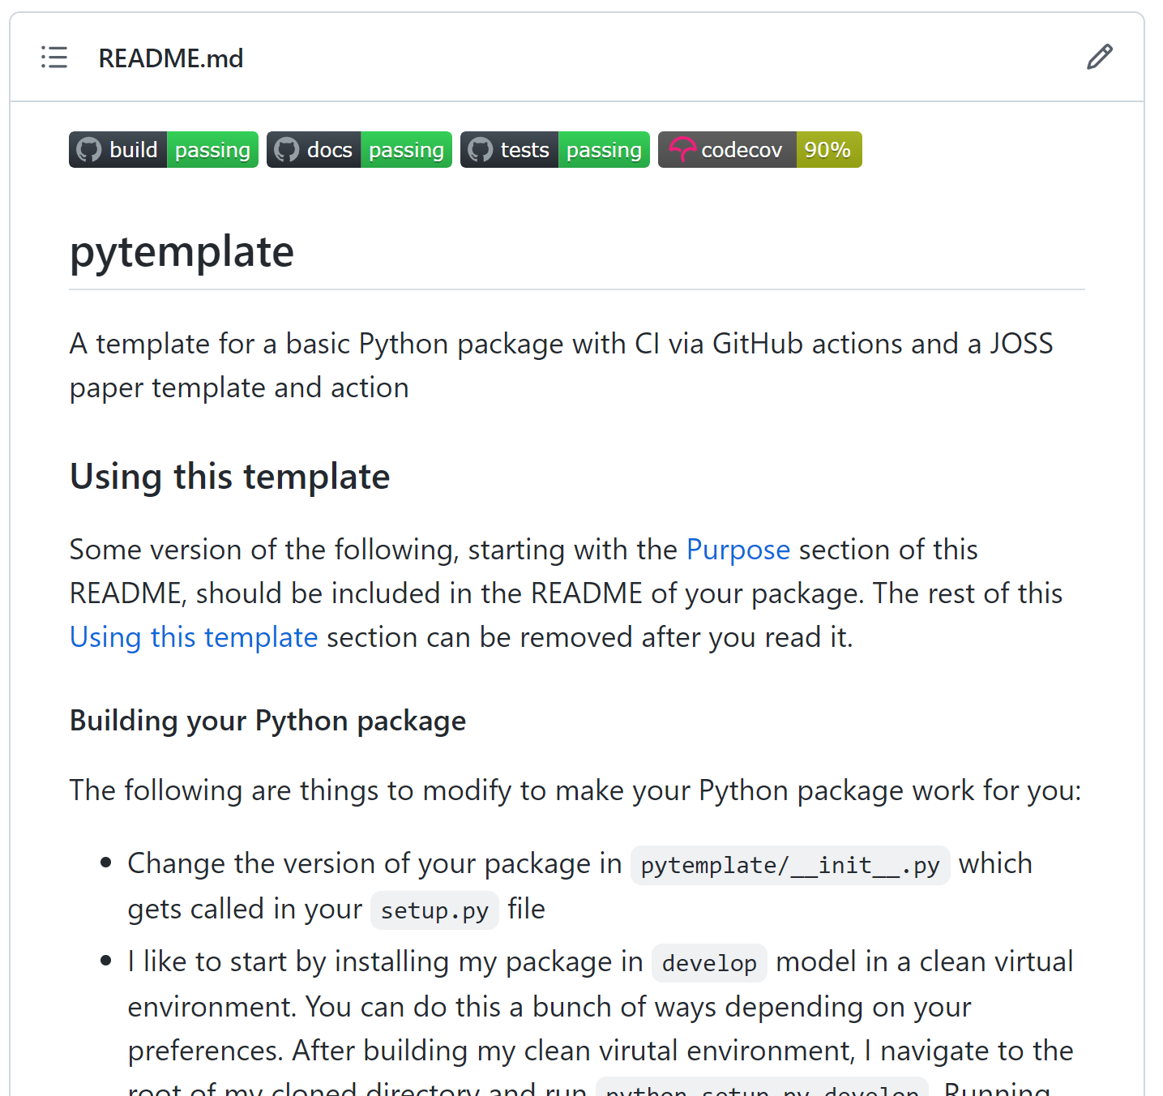
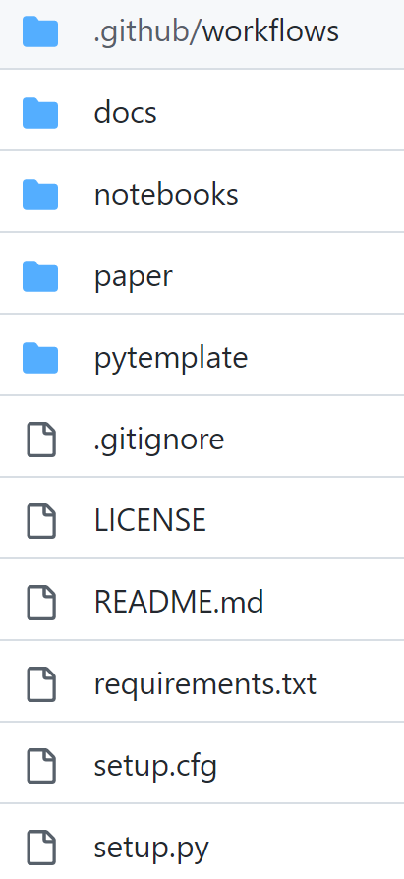
1. Packaged Models: Any Stranded Scripts?
Clear Templates for Packages
https://github.com/JGCRI/pytemplate
Individual Package Design
Folder Structure
Continuous Integration
Multi OS Build Checks
Code Testing
Documentation

Slide 6
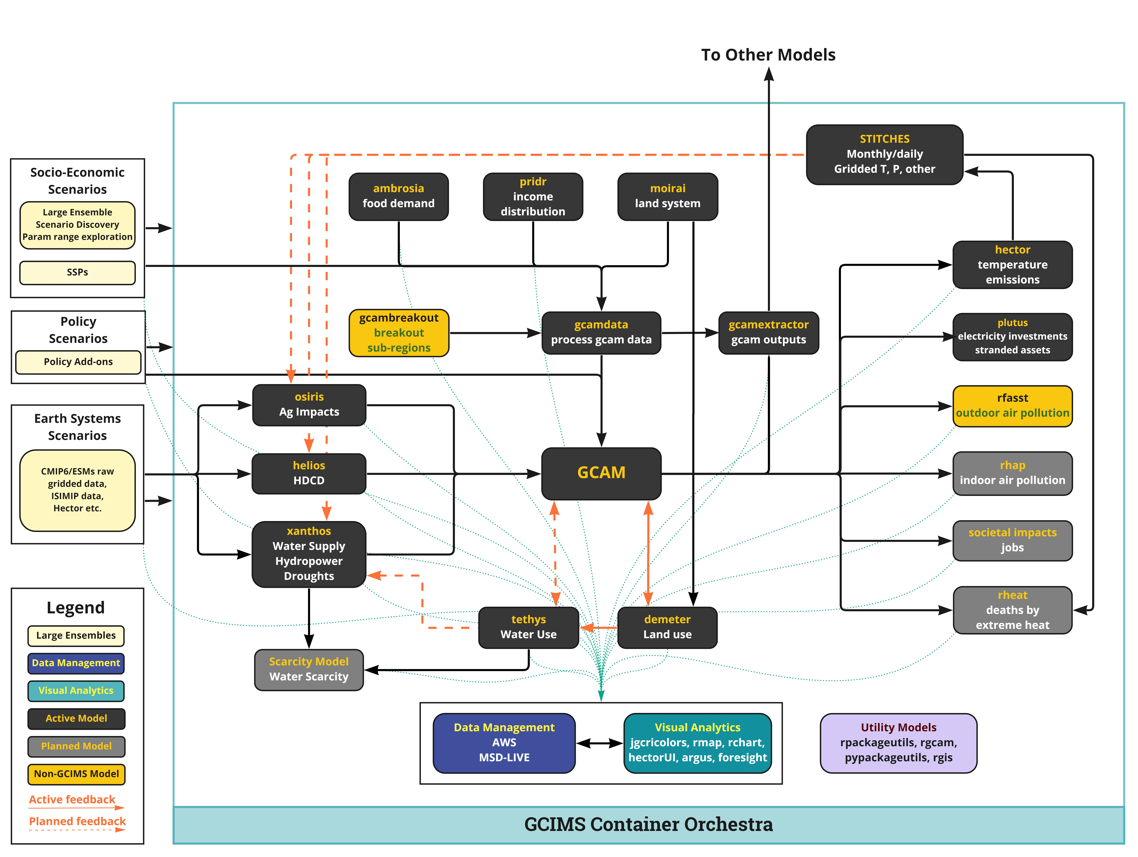
2. Software Map: What can we do?
Software Map
https://jgcri.github.io/gcims_integration/software.html
Track down and Map out
Data sources
Existing models
Planned models
Inter-linkages

Slide 7
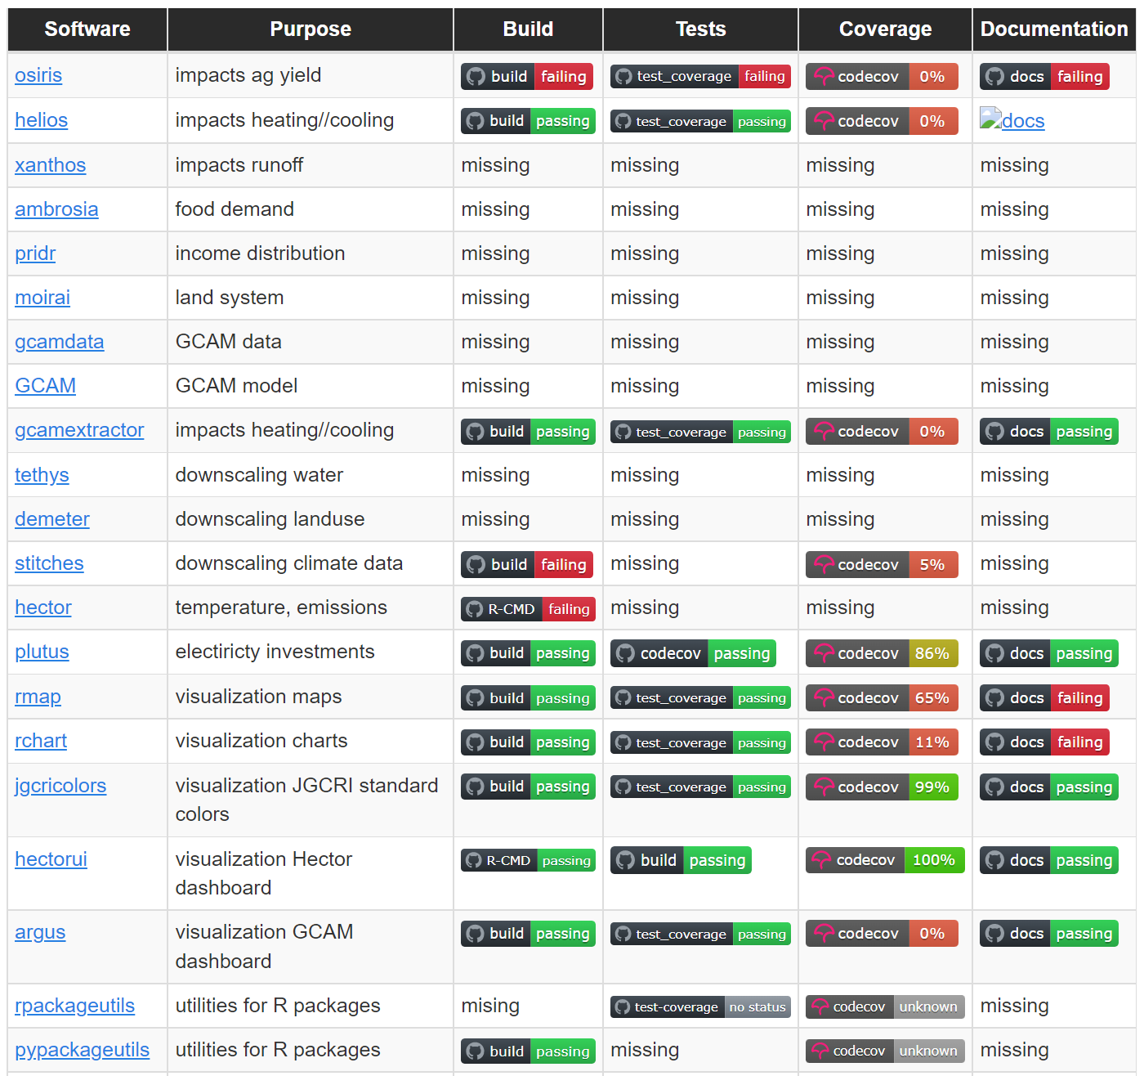
3. Software Health: Does it work?
Overall System Health Monitoring
https://jgcri.github.io/gcims_integration/software.html
Overall System Monitoring
Continuous Integration
Multi OS Build Checks
Code Testing
Code Coverage
Documentation

Slide 8
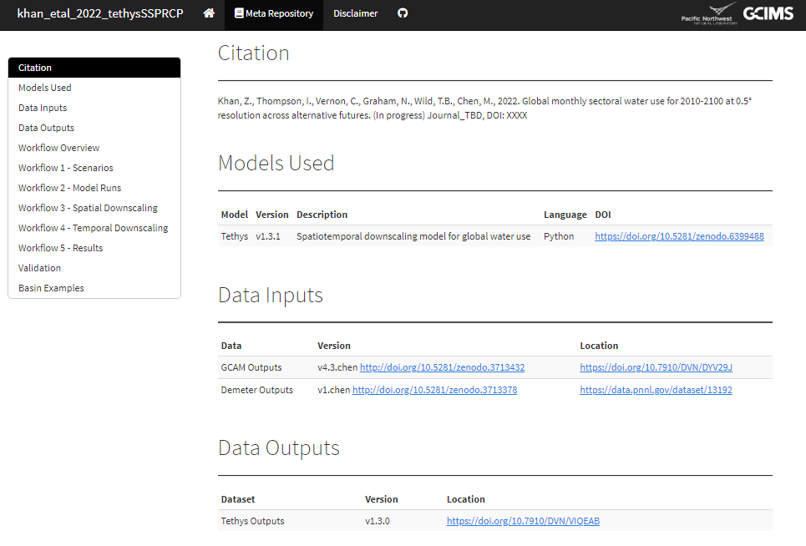
4. Reproducible Workflows: Can we do it again?
Reproducible Workflows
https://jgcri.github.io/khan-etal_2022_tethysSSPRCP/metarepo.html
Reproducible workflows
Meta-repo templates
Inputs with DOI
Outputs with DOI
Workflows
Validation
Results
Containerization
Scalable
Cloud/On-prem/hybrid

Slide 9
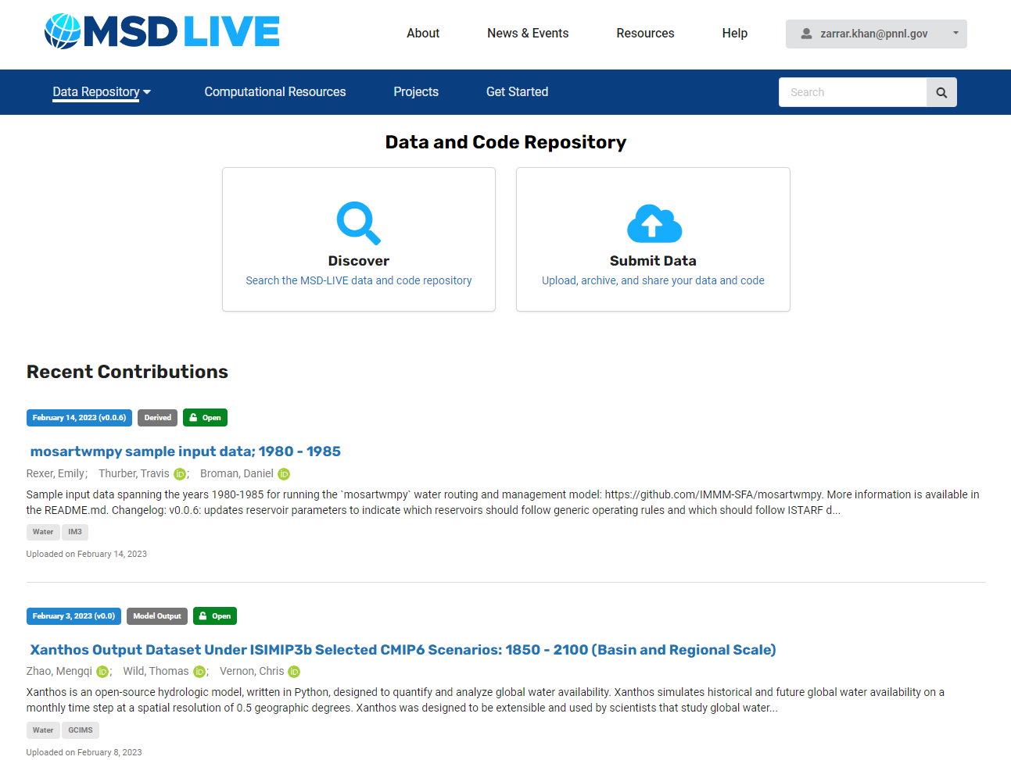
5. Data Management: How to re-use what we did?
Persistent Data Management
https://data.msdlive.org/
Persistent Data Management
FAIR
Findability
Accessibility
Interoperability
Reusability
Key Features
Minted with DOIs
Meta-data
Storage (MSD, Deception, Cloud)

Slide 10
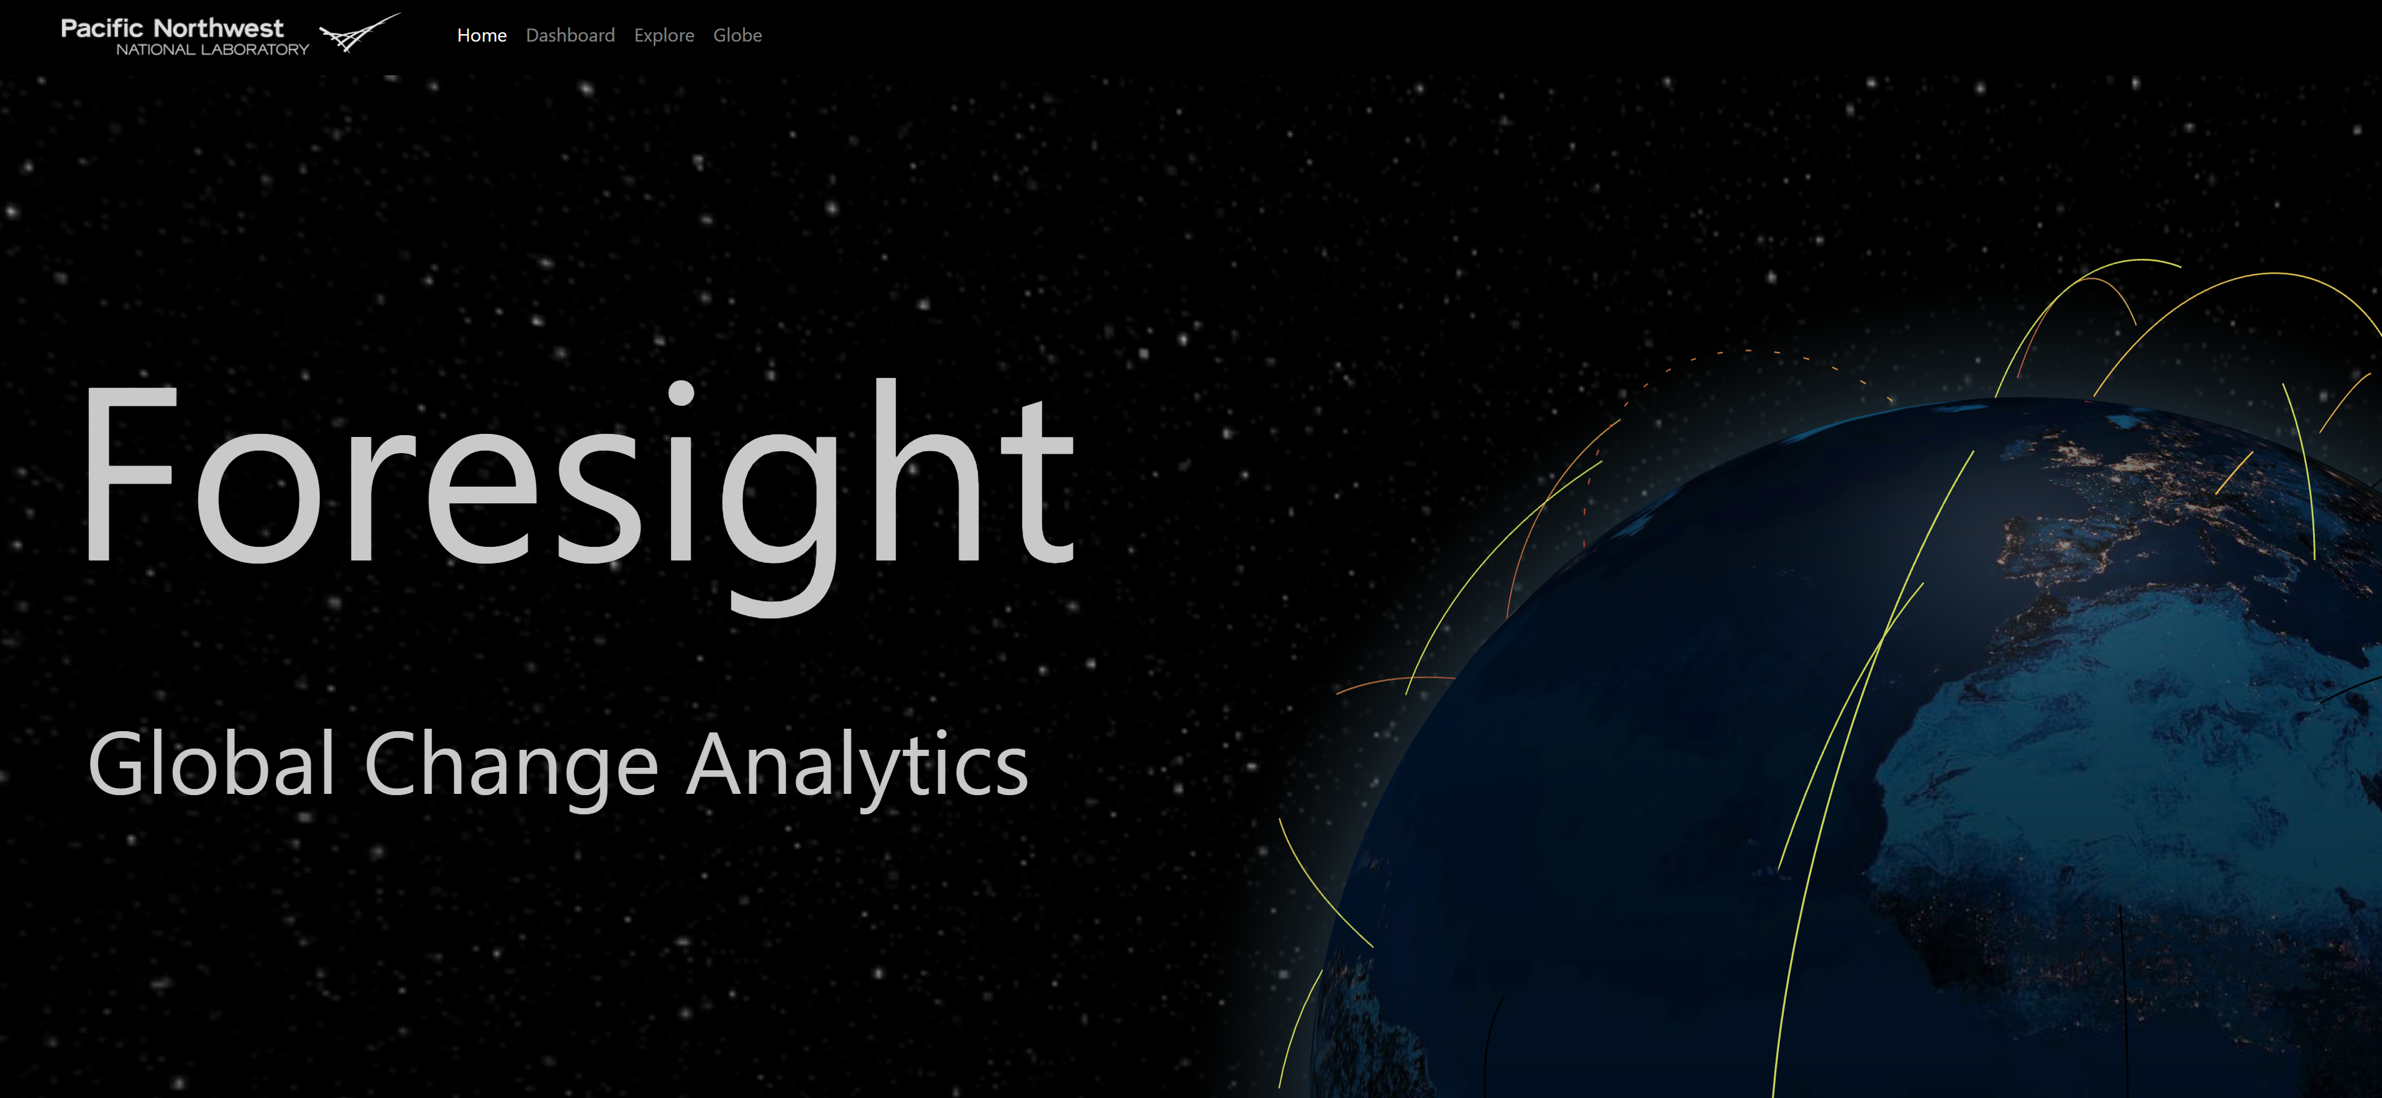
6. Persistent Insights: Share what we did
https://jgcri.github.io/foresight

Slide 12
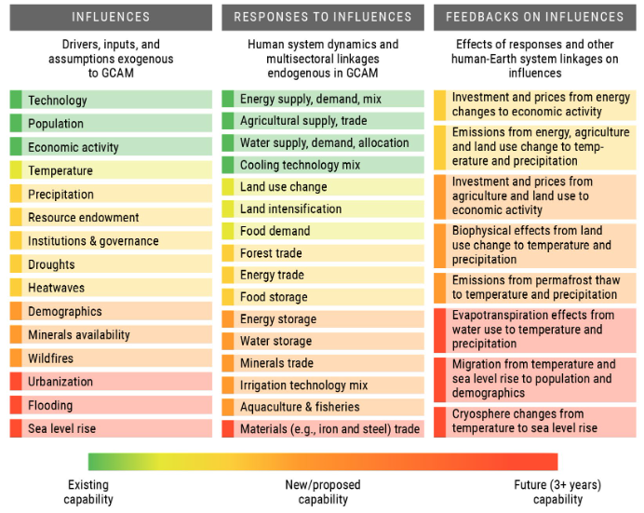
Eecutive Summary from GCIMS Proposal
Science Question 1: How will compounding human and environmental influences affect the coevolution of energy, water, land, climate, and socio-economic systems, and what individual and combination of influences lead to compounding effects within the U.S. and globally?
Science Question 2: How will regional teleconnections via resource supply networks and trade create, amplify, or attenuate the responses associated with different influences in the U.S. and other parts of the world, and how will varying assumptions about the ease or difficulty of trade alter these teleconnections?
Science Question 3: How will human responses to short-term influences through investments in long-lived capacity and in storage technologies in the energy, water, and land systems affect the long-term dynamics of these systems, and how will these investments affect the ability to respond to future influences in the U.S. and globally?
Science Question 4: How could the response of the human–Earth system to influences create feedbacks that are currently not captured in integrated modeling frameworks, and which feedbacks
Figure B.1. Typology of influences, responses, and feedbacks in the GCIMS SFA
https://gcims.atlassian.net/wiki/spaces/HOME/pages/190513175/Official+copy+of+the+proposal+FY21-23

Slide 13
Task 4.2 Description in Proposal
The experiments proposed in this SFA require linking influences, responses, and feedbacks. In GCIMS, the representation of these processes occurs in different models. For example, Hector and fldgen model climate-related influences, while Persephone and Xanthos calculate the effect of changes in climate on land productivity and water availability, respectively. GCAM models the responses to influences. Representing environmental feedbacks can require spatial disaggregation of outputs from GCAM via Tethys (water) and Demeter (land) and/or links back to Hector. In the previous phase of the SFA, we developed a tool, Cassandra, to facilitate linking between GCIMS components. However, this tool has only been successfully tested using our climate emulators in combination with Xanthos.
To facilitate the coupling required in the experiments described above, we need two separate but related efforts.
First, Cassandra will need to be extended to facilitate a variety of coupling options, including time step by time step transfer of data from multiple modeling components. We will implement each model and tool within Cassandra and ensure compatibility with Cassandra’s requirements as described in Task 4.1. We will establish a standard testing process for all required Cassandra couplings.
Second, GCAM will need to be updated to facilitate coupling with other GCIMS components. Most of the models in GCIMS were developed in high-level languages such as R or Python. However, GCAM is written in C++. We will use frameworks, including `Rcpp` and `Boost.python`, to make the C++ code available directly from R and Python, respectively. In addition, we will provide an API for the other GCIMS components to update GCAM parameters or retrieve results throughout the model simulation period. In the previous phase of the SFA, we developed a generic API called GCAM-Fusion. Given GCAM’s object-oriented, hierarchical, and dynamically configured design, GCAM-Fusion is implemented as a query-based system. Thus, for users to update “power plant costs” or retrieve “land allocation,” for example, they must know how to develop the specific query to access that information. This requires users to know where that data exists in GCAM, and as GCAM is further developed those queries may change. We will fill out a library of common queries that users can readily pick from and which we will maintain over time. As a result of this task, GCAM will be accessible from R and Python to couple to other models or for interactive use, and users will have a readily available set of predefined queries to get data in and out of GCAM. (GCAM-wrapper)
https://gcims.atlassian.net/wiki/spaces/HOME/pages/190513175/Official+copy+of+the+proposal+FY21-23

Slide 14
GCIMS Integration - Motivation
Selective Interoperability: Coordinate efforts to push our models into selective interoperability (not an über model, but more of a choose your own adventure) on demand for research needs
gcamwrapper: Getting gcamwrapper production ready as it will be the hub to interact with GCAM
Expand component library: Expand the current component library to be more granular (this transitions our workflows into reusable, bite sized pieces that can be shared and promote robust test suites can be built for centrally) – Actively find and avoid Redundancy.
Fluid multi-model integration: Highly coordinated, highly automated, high communication, integration across the board for all of our modeling components (hector, xanthos, GCAM, demeter, etc.)
Redeployable/Scalable Space: Moving our integration into redeployable and scalable space so we can push our experiments to cloud compute platforms if need be
Education/Useability/Transparency: Empower people to use our tools and extract insights that matter
Pilot-tests/Indicators: Working with other experiments to identify key metrics and indicators that are meaningful and get buy-in using small pilot projects to demonstrate capabilities

Slide 15
GCIMS Integration - Plan
Software Map: Track models and packages and interconnections
Standards: Optimize efficient storage and I/O, pypackageutils, rpackageutils
Workflows: Containerization Orchestration, Robustness, Scalability, CI/CD
Feedbacks Architecture: gcamwrapper, gcimswrapper
Data Management: Central, traceable, provenance, QC/QA’d integrated with CI/CD
Visual Anlaytics: Share, Track, Diagnose, Indicators, Impact Metrics

Slide 16




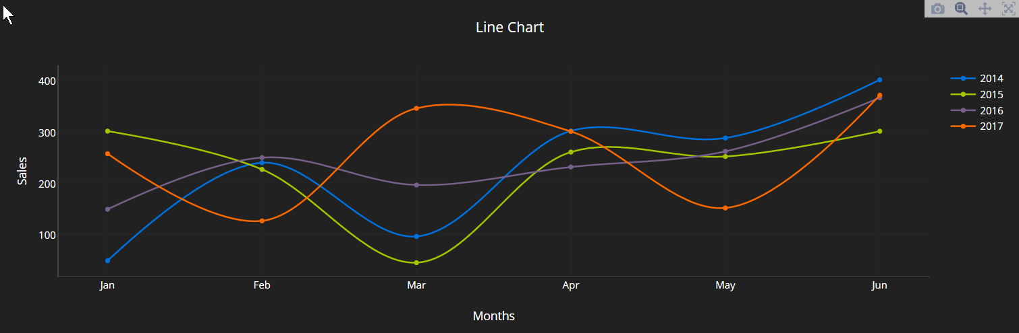
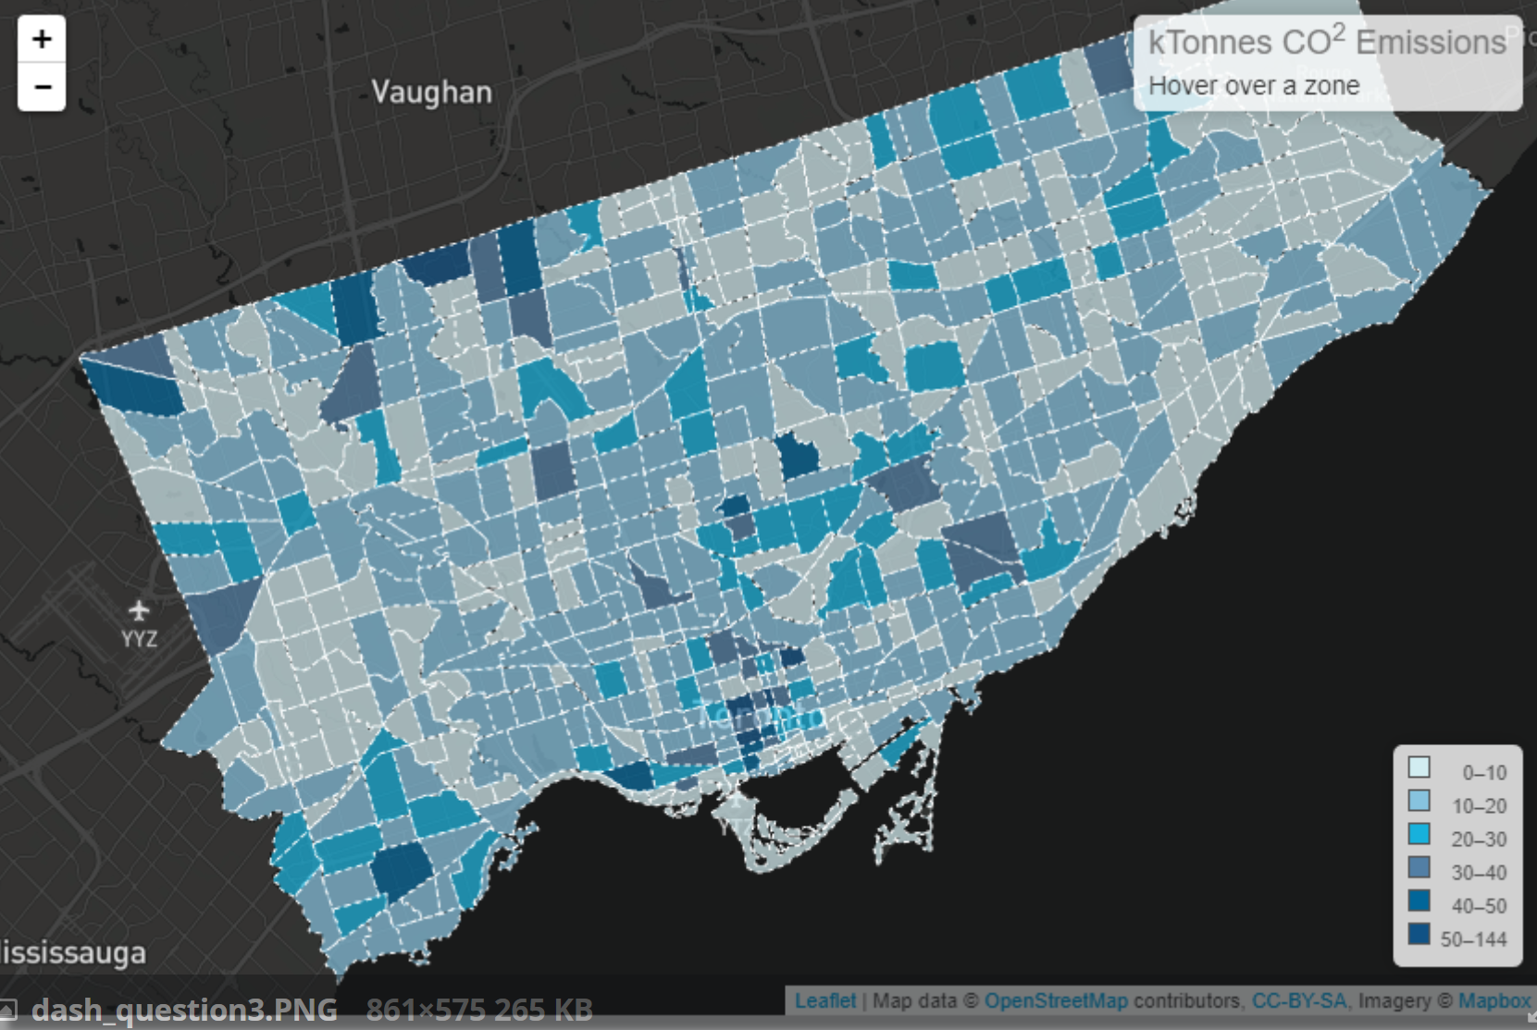
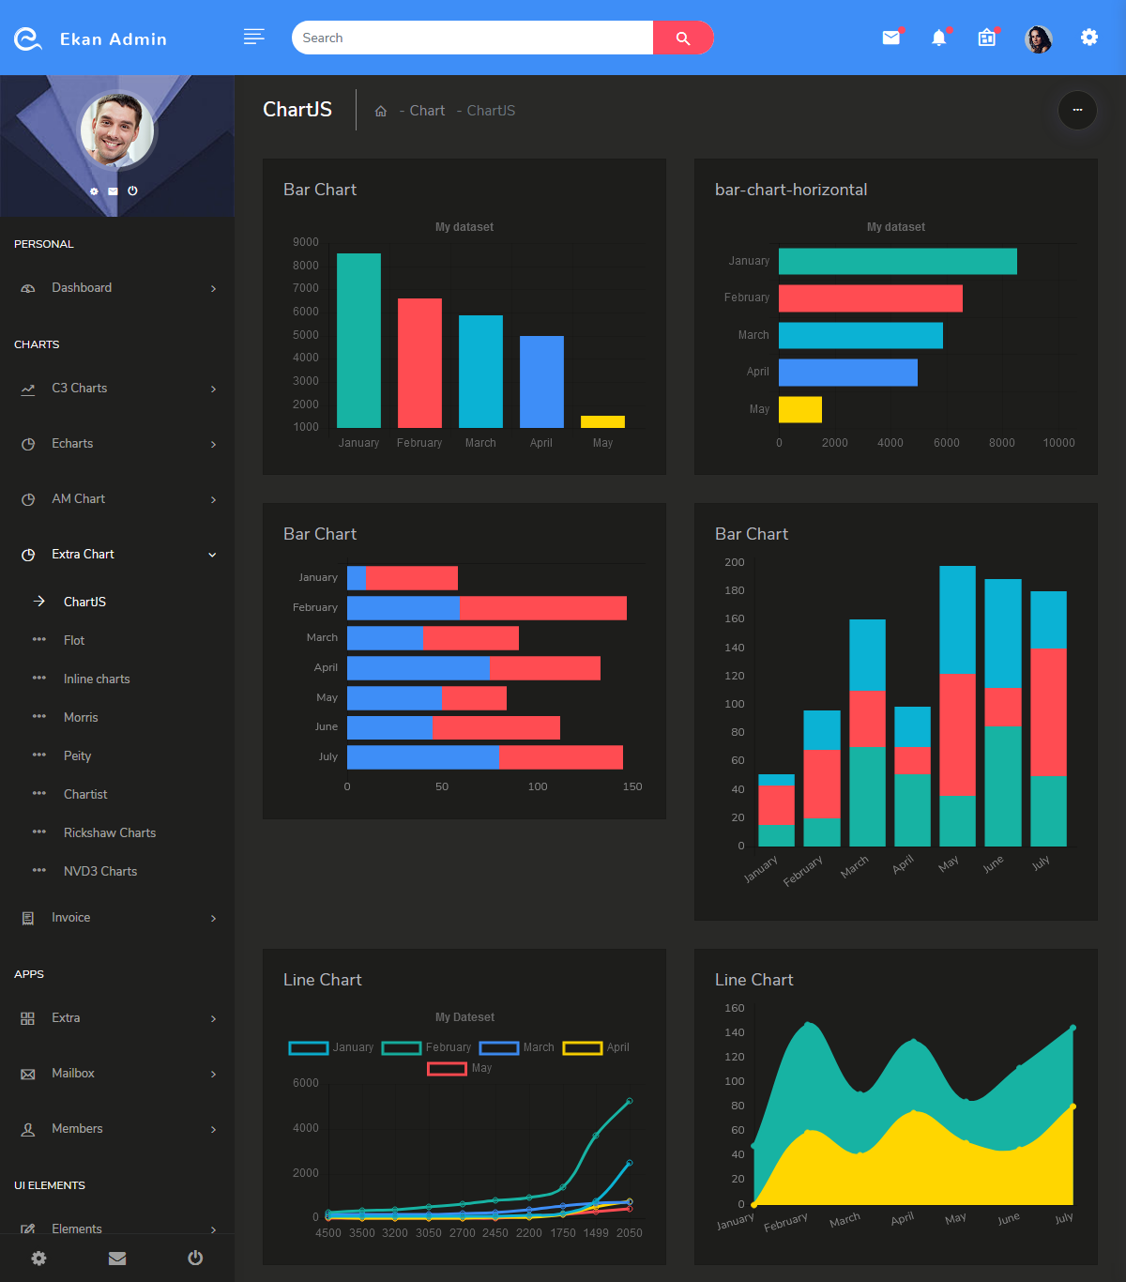

Visualize: Share what we did
Focus Multi
Foresight
Dataset: CMIP6
Base Year: 2015
Base Scenario: Scenario 1
Underlayer: County
Parameter: Water Demands
Difference: Abs % - -
Overlayer: Basin

Slide 17

Visualize: Share what we did
Focus Multi
Foresight
Dataset: CMIP6
Base Year: 2015
Base Scenario: Scenario 1
Underlayer: County
Parameter: -
Difference: Abs % - -
Overlayer: Basin
Water Supply
Water Demands
Landuse
Scarcity

